Slide 1
Advance wars concept
Made by Pavlo Konovchenko

Slide 2
30 seconds of fun
You start on a battlefield with a lot of troops to control. Command your army of soldiers, tanks and helicopters with strategy and cunning to outsmart your opponents, while capturing important points of interest. With a variety of troops and different terrain, no battle will ever be the same. Test your tactical genius!

Slide 3
Background
The game takes place in our day and age, where a conflict between two superpower countries, the USA and China, sparked World War 3. Battles for world dominance rage across the entire world, with each country taking sides. As alliances shift, you will play as one of the commanders trying your best to lead your army to victory.

Slide 4
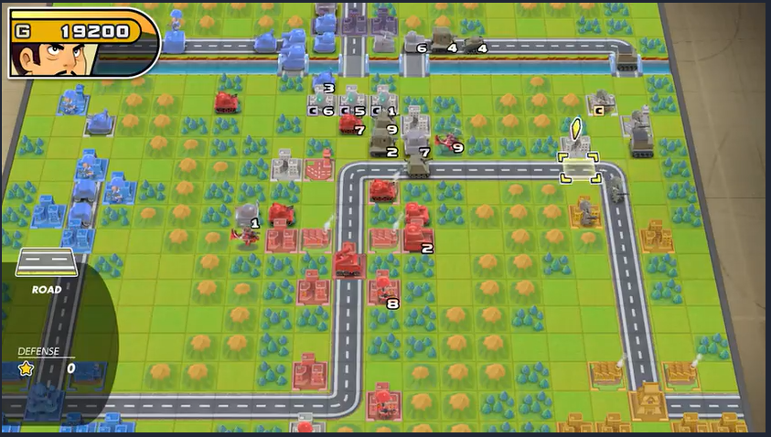
Screen shot

Slide 5
Features
Moving troops, while navigating different terrain
Battling other troops
Creating new troops
Capturing points of interest such as towns and factories

Slide 6
Pillars
Battling other troops 50% Choose between your units (infantry, tanks, helicopters or ships) to fight against enemy military, while choosing your unit wisely and avoiding your opponent’s forces (e.g., using a helicopter against infantry is good, but using a helicopter against Anti-Air is bad).
Creating your troops 25% Analyzing what battalions your enemy has, to spend money on creating counters of them or spawning units that you might desperately need, such as infantry carriers to move your soldiers quicker.
Capturing points of interest 25% Making sure that through out the game you have more towns, that increase the flow of money you receive, and factories, which allow you to spawn more units, by battling for them.

Slide 7
Skills students will use
Classes [infantry, tanks, helicopters (would all derive from class troops)]
Arrays [troops, towns, factories]
Graphics [sprites of each unit type, building type, animation for units moving across the map and battling]
Source control [Git, github]
Software [VS2022, Photoshop, Sony Vegas Pro, Audacity]
Teamwork

Slide 8
Elements
Visual Asset Creation [0-25]
Draw cartoonish tanks, soldiers etc. from side perspective [5]
Audio Asset Creation [0-5]
Distort car sounds for tanks, record a few voice lines for infantry [5]
Menu System [0-15]
Menu with units showcase where you can see all the troops and their stats, before starting the game [10]
HUD [0-15]
The amount of damage you are going to deal to an enemy troop, current money, number of buildings owned [10]
Basic Game Play [20]
Move troops, fight other troops, create new ones [20]

Slide 9
Elements
Graphics [20]
Text, fonts, sprites, rotating sprites [20]
Advanced game play [0-20]
Different kinds of troops to choose from, a few maps [10]
Advanced Graphics [0-20]
Animation for troops and fights to mimic an actual battle [10]
Video [5]
Project Management [5]

